Slide 1
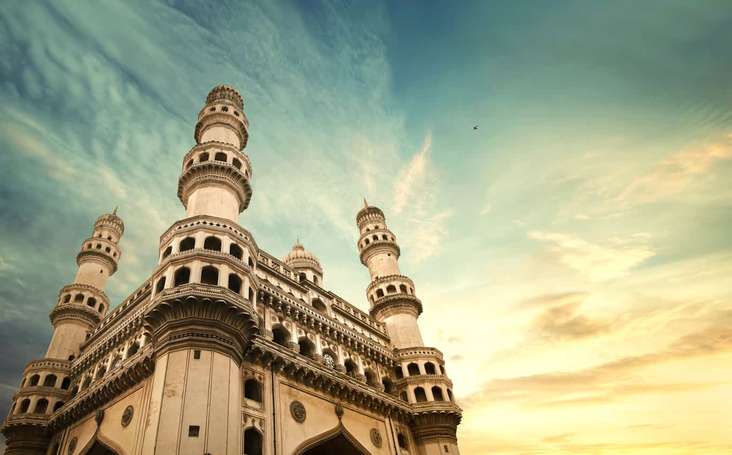
Telangana Tourism: Insights & Recommendations
Presenter: Gurjeet Singh Sodhi
Image: Charminar,Hyderabad

Slide 2
Table of contents
Problem Statement
About Telangana
About Data
Insights & Recommendations
Overview
Data Cleaning & Processing

Slide 3
Problem Statement
Telangana is one of India’s leading states in various sectors, has published its tourism data under its open data policy.
As a data analyst, my task is to analyze the given visitor data
(Domestic & Foreign Visitors) for 2016-2019, do additional research and provide data-informed recommendations to the Telangana government which can be used to increase their revenue by improving administrative operations.

Slide 4
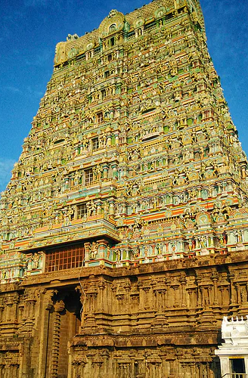
About Telangana
Image: Sri Raj Rajeshwara Temple

Slide 5
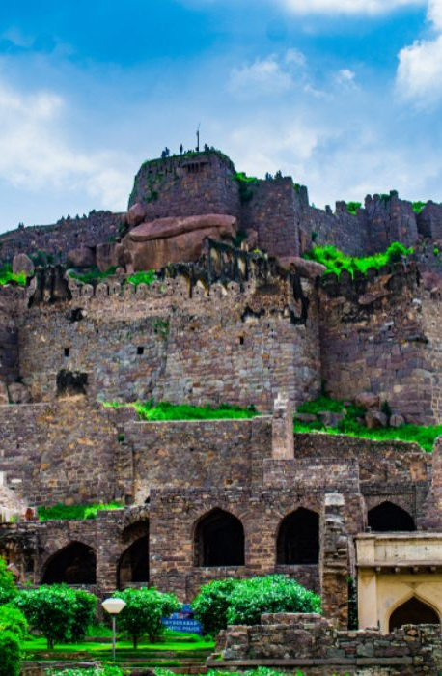
Genealogy of Telangana
Telangana, the 29th State of India is located in the southern part of country and is renowned for its natural attractions, temples, palaces, forts and other heritage sites. The rich cultural heritage of the state makes it one of the most visited tourist destinations in South India.
Image: Golconda Fort

Slide 6
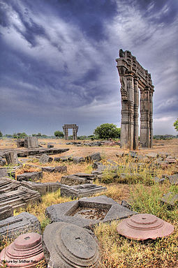
About Data
We were provided with two folders which contained domestic and foreign visitor data for Year 2016-2019. Column description is as follows:
district: The name of the district in Telangana.
date: The starting date of the month when the tourist data was collected for the specified district.
month: The month for which the tourist data is being reported.
year: The year is in YYYY format.
visitors: The number of visitors who visited the given district in Telangana during the specified month. We have two categories of visitors i.e. Foreign and Domestic Visitors.
Image: Kakatiya Kala Thoranam

Slide 7
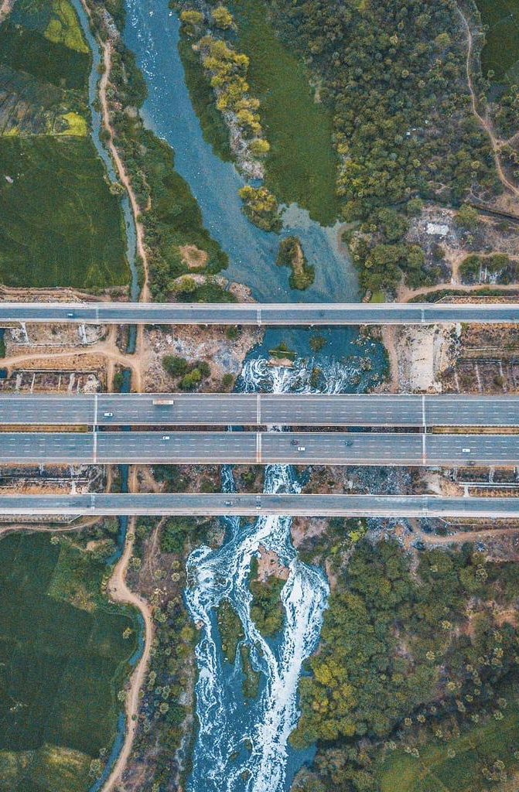
Additional Data
Collected additional information via google, Column description is as follows:
area: area of each district.
population: population of each district, density of population.
road: major district roads, state highways and rural roads.
tourist spot: Number of tourist spots in each district including TSTDC units.
Other miscellaneous data: Literacy rate, urban and rural %, sex ratio and total number of villages.
Image: Musi River, Hyderabad

Slide 8
Data Cleaning & Processing
Steps Performed:
Concatenated all files using Pandas and created one file containing foreign and domestic visitor data.
Inserted Visitor Type column.
Change date format to dd-mm-yyyy using Pandas Datetime module.
Removed leading and trailing whitespace from visitor and district column.
Removed empty string and null values from visitors column an replaced it with 0.
To make the data consistent, changed Warangal (urban) to Hanamkonda and Warangal (rural) to Warangal. Click here for more information.

Slide 9
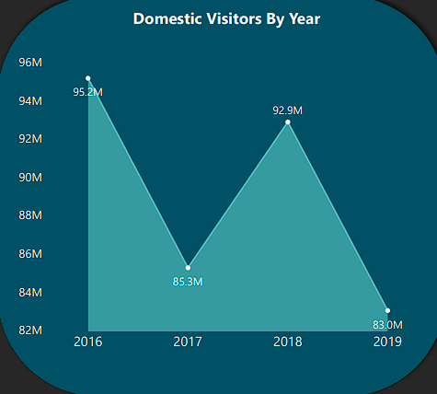
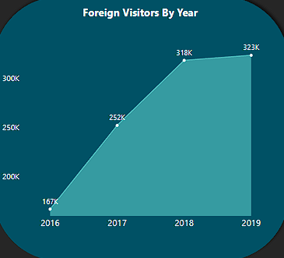
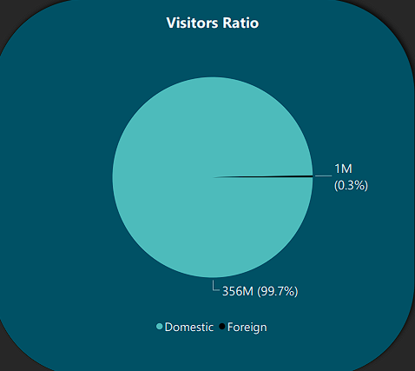
Overview
We notice a sharp decline in Domestic visitors from 2016 - 2017 and an overall declining trend.
There is a steady increase in Foreign visitors which can be attributed to promotion of MICE and Medical Tourism in the State.
Domestic Visitors contributes 99.7% and Foreign Visitors contributes 0.3% of Total tourism in the State.

Slide 10
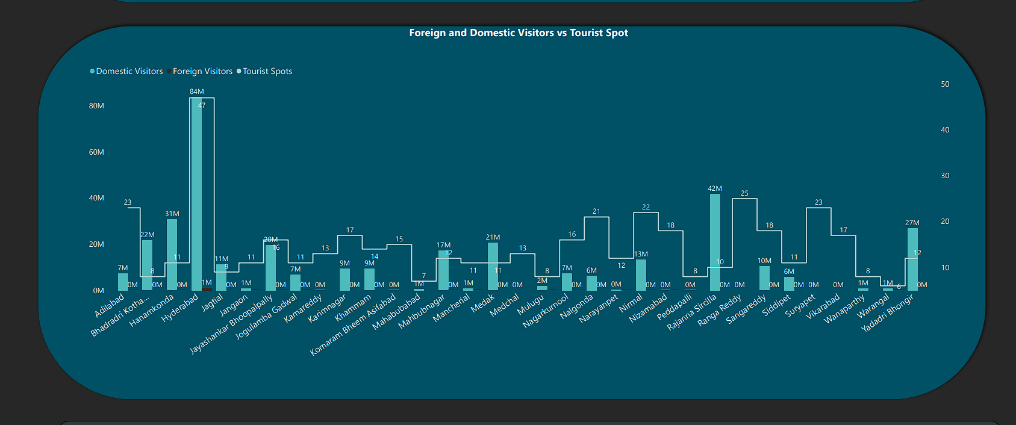
Overview
Hyderabad with 47 tourist spots has highest footfall of Domestic (84 Million) and Foreign Visitors (1 Million).
Ranga Reddy, Suryapet and Vikarabad have no visitors although they have 25, 23 and 17 tourist spots respectively.
Bhadradri Kothagudem, Hanamkonda, Jagtial and Rajanna Sircilla has Domestic footfall but no Foreign visitors.

Slide 11
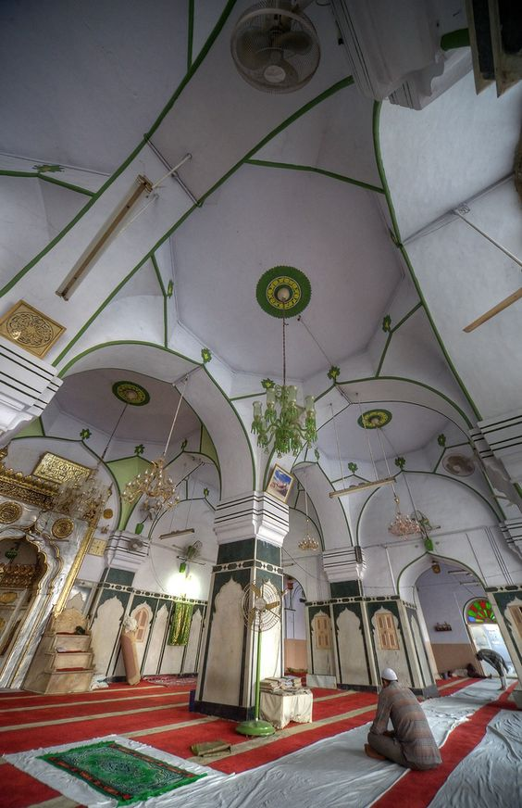
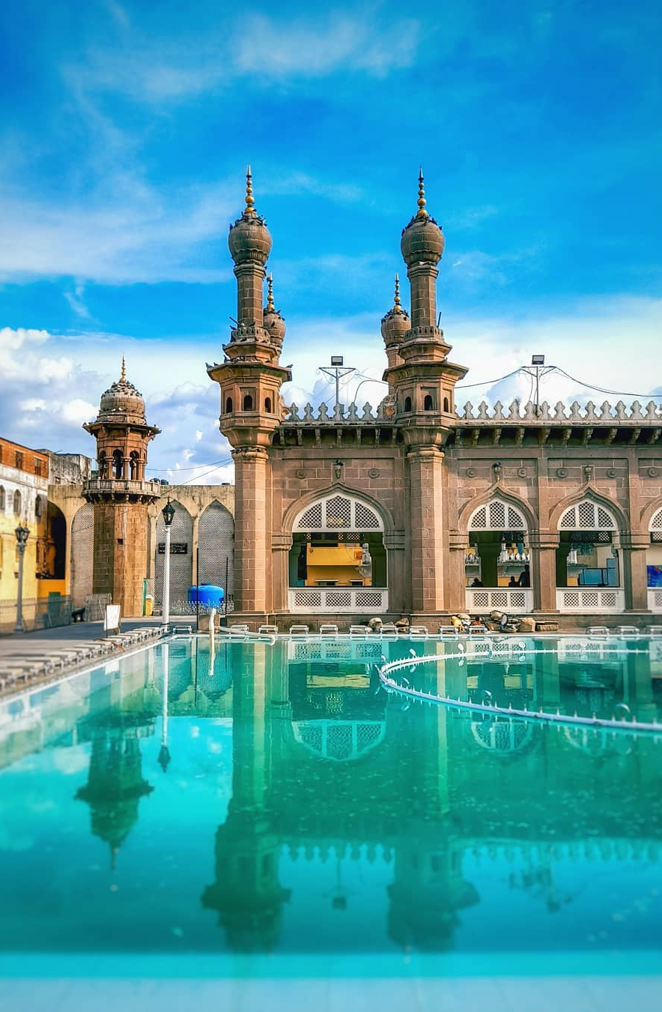
Insights & Recommendations
Image: Makkah Masjid, Hyderabad

Slide 12
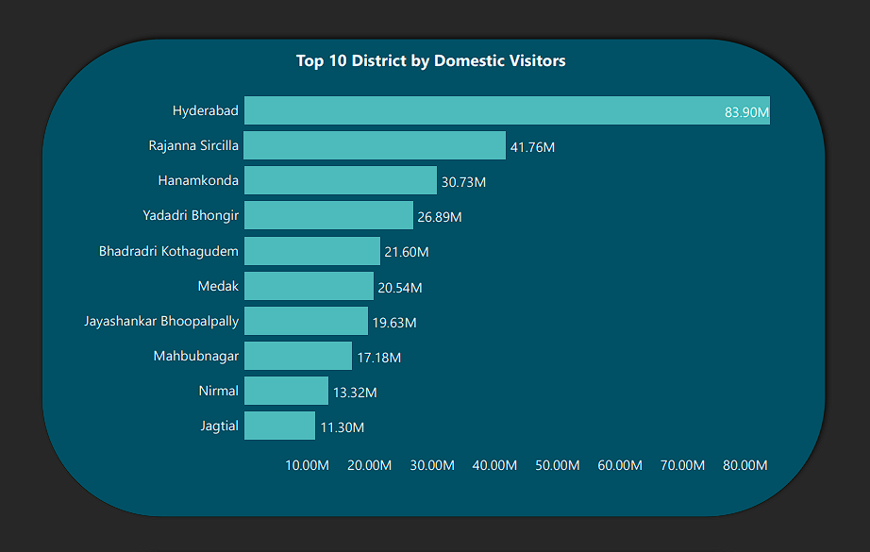
Research Question
List Down the Top 10 District that have highest domestic visitors overall (2016-2019)?

Slide 13
Insights & Recommendations
Hyderabad being the state capital has the highest Domestic visitors (83.90 Million). It has several historical sites that attracts tourists, including the Charminar, the Golconda Fort, and the Qutub Shahi Tombs. Also a major business and education hub, this contribute to the high domestic visitor rate in the city, as visitors may combine business or educational trips with leisure activities.
Rajanna Sircilla has 41.76 Million Domestic visitors which can be attributed to a combination of factors such as religious significance for example: The Vemulawada temple, which is dedicated to Lord Shiva, and the Kaleshwaram temple, which is situated on the banks of the Godavari river. These temples have religious and cultural significance for which they have a high footfall of visitors. It also has several lakes and reservoirs, including the Konda Pochamma Sagar and the Pocharam Wildlife Sanctuary. Visitors from across the nation are interested in birdwatching, boating, and hiking in these natural areas.
Warangal Fort, which is a popular tourist attraction is situated in Hanamkonda which has 30.73 Million Domestic Visitors was built in 13th Century. Additionally Hanamkonda is known for its rich culture and visitors are interested in experiencing the local culture and cuisine.
Telangana state government has employed a proactive approach and launched several initiatives to promote tourism. These top 10 districts have benefited from such initiatives, which has contributed to the high domestic visitor rate in the state.

Slide 14
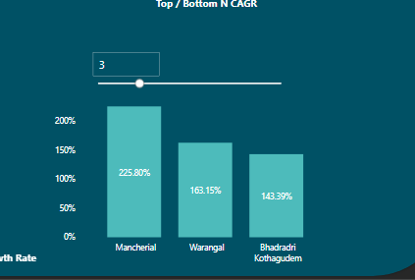
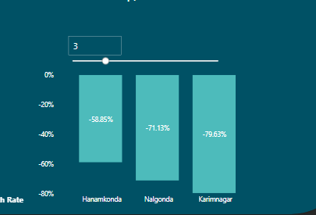
Research Question
List down the top/bottom 3 districts based on Compounded Annual Growth Rate (CAGR) of visitors between (2016-2019)?
Top 3
Bottom 3
Notes:
CAGR term of economicsannual growth of your investments over a specific period of time. CAGR is a mathematical formula that provides a "smoothed" rate of return.

Slide 15
Insights & Recommendations
Mancherial being well connected via road (111 kms State Highway) and Railways has the highest CAGR. It is home to several forests and wildlife sanctuaries and is also significant to tribal population of Vindhyachal region (Maharashtra & Chhattisgarh) who participate in various cultural activities like Jataras in the area.
Warangal and Bhadradri Kothagudem are at the 2nd and 3rd spot as they have places of rich cultural heritage. Overall these districts cater to every kind of tourist: from nature lovers and history buffs to religious pilgrims and adventure seekers.
Karimnagar with a declining rate of -79.63 % has seen only 0.1 Million Domestic visitors in 2019 as compared to 9.2 Million in 2016. State government has allocated Rs 100 crore for the Manair River Front (MRF) to boost tourism in the district. More TSTDC units can be set up and an assessment of 17 tourist spots should be done in order to ensure more footfall.
Nalgonda and Hanamkonda have also seen a declining trend in Domestic visitors from 2016 to 2019. This can be due to lack of promotion as compared to other tourist destinations in Telangana. Places like Nagarjuna Sagar Dam which is India’s largest Masonary Dam is situated in Nalgonda should be advertised well in order to attract more visitors.
There are no Foreign visitors in Karimnagar and Nalgonda although they have 17 and 21 Tourist Spots respectively. Factors affecting this can be lack of infrastructure, poor Administration and Management, Transportation facilities. Government should create a workplan and optimize funds in order to attract more Foreign Visitors in these districts.

Slide 16
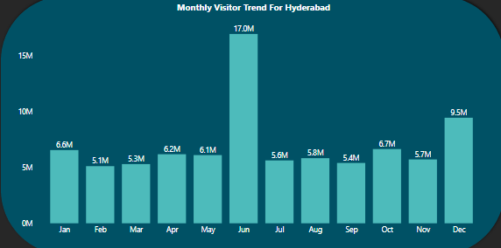
Research Question
What are the Peak and Low season months for Hyderabad based on data from 2016-2019?

Slide 17
Insights & Recommendations
Hyderbad is always a pleasant city to visit anytime of the year but it experiences highest number of visitor footfall in June (17 Million) as it gets less warm and breezy as this is the time we can expect monsoon. Additionally, schools and colleges have a break during June, hence many Indian families plan their vacations during this time.
Least footfall is noticed during February-March which can be attributed to high temperature.
Telangana government can take several steps to attract more visitors during the low season. For example: There are 8 TSTDC units spread across Hyderabad, these units can organize indoor events like food festivals, music concerts, art gallery and museum tours to attract more visitors.
Government can also improve its marketing and advertising efforts during low season by collaborating with travel bloggers and influencers in order to attract more visitors.
MICE (Meetings, Incentives, Conferences, and Exhibitions) is an important segment of the tourism industry in Hyderabad. Discounted rates, collaborating with event organizers and promoting business facilities during low season months will also attract more Foreign visitors.

Slide 18
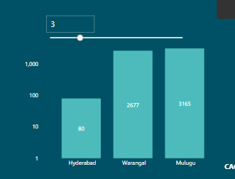
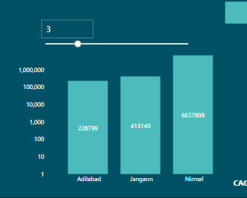
Research Question
List down the Top & Bottom 3 Districts with high Domestic to Foreign Visitor Ratio?
Top 3
Bottom 3

Slide 19
Insights & Recommendations
Hyderabad, Warangal and Mulugu are the top-3 districts with low Domestic to Foreign Ratio which indicates that the tourist spots in these districts are equally exposed to Domestic as well as Foreign visitors.
Lower Domestic to Foreign Ratio is an indicator of increased tourism revenue, as Foreign visitor tend to spend more money on their travels.
Adilabad, Jangaon and Nirmal are at the bottom with high Domestic to Foreign Ratio.
Adilabad and Jangaon have no TSTDC units and a rural % of 76.34 and 87.40 which indicates that these places have limited transportation and infrastructure options, which can make it difficult for Foreign visitors to access and explore tourist spots in these districts. Although rural areas can also offer unique and authentic cultural experiences that can be very attractive to Foreign visitors. For example, rural areas may be known for their natural beauty, traditional crafts, or unique cuisine. By highlighting these distinctive qualities and marketing them effectively, rural areas can attract a diverse range of domestic and Foreign visitors.
Encouraging residents to set up Homestays can help Foreign visitors understand and appreciate the local culture, which can increase their comfort level hence attract an equal number of visitors.

Slide 20
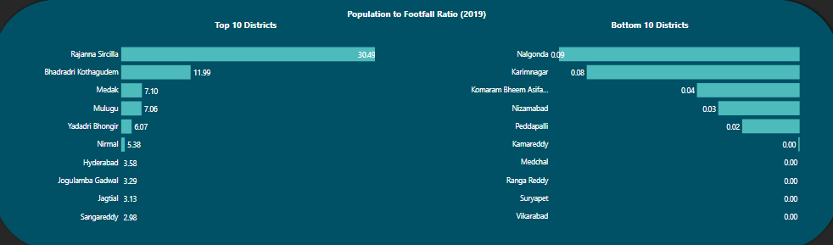
Research Question
List down the Top & Bottom Districts based on Population to Tourist Footfall Ratio in 2019? (Ratio: Total Visitors/ Total Resident Population)

Slide 21
Insights & Recommendations
Rajanna Sircilla is at the top which indicates that tourist spots in this district are attracting a lot of visitors and it has a thriving tourism industry.
This high ratio is an indicator of increase in economic benefits such as increased employment, higher revenue for businesses, and tax revenue for the government.
On the contrary low ratio represents lack of tourism activity in the district which means missed economic opportunities for local communities. It also indicates lack of awareness or interest in the tourist spots, or challenges with marketing and promoting the tourist spots effectively.
Tourism department should provide new tourism experiences like cultural tourism, adventure tourism, ecotourism, wellness tourism in order accommodate more tourists in the bottom 10 districts. It can also deploy Tourist Information Kiosk at major Cities, Airport, Bus and Train Stations in order to spread awareness about the attractions and tourist spots present in these areas so that Visitors can add these places in their travel itinerary.

Slide 22
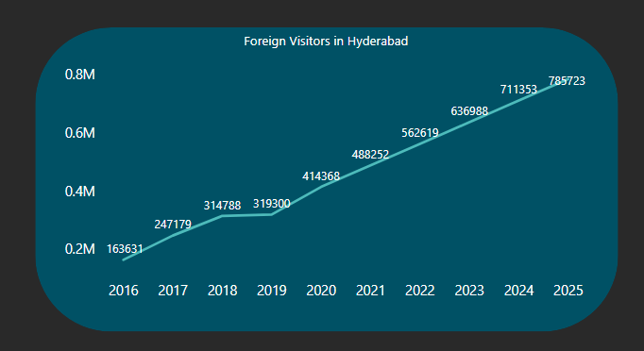
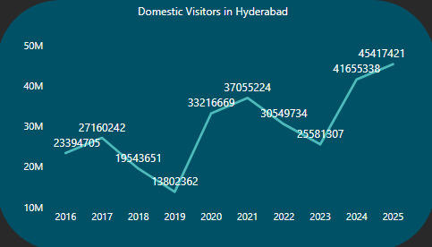
Research Question
What will be the Projected number of Domestic and Foreign Visitors in Hyderabad for 2025 based on the Growth Rate from previous years?

Slide 23
Insights & Recommendations
There is a steady increase in Foreign Visitors and we can expect 7.85 Lakh Foreign visitors in Hyderbad for 2025.
There is a lot of variation in the Domestic Visitor footfall each year and we can expect 4.54 Million Domestic Visitors for 2025.
The above forecasting will enable government to plan and develop Infrastructure i.e. Improve transportation, Accomodation such as Hotels, Guest Houses, Hostels and Homestays, Install Tourist Information Centres which can address to visitors doubts & queries, Hire guides who can provide a detailed tour of Tourist attractions in Hyderbad.

Slide 24
Research Question
What will be the Projected Revenue for Hyderabad in 2025 based on the average spend per Visitor? (Foreign Visitor: ₹ 5,600 & Domestic Visitor: ₹1200)

Slide 25
Insights & Recommendations
Projected Revenue for Hyderabad in 2025 will be ₹58.90 Billion.

Slide 26
Research Question
Districts with Highest Potential?
Hyderabad
Warangal
Bhadradri Kothagudem
Mancherial

Slide 27
Insights & Recommendations
Hyderabad being the capital of the state has the highest potential as it is a major hub for MICE and Medical Tourism along with several historical sites like Charminar, Golconda Fort, Ramoji Film City, Birla Mandir etc.
Warangal also has a high potential as it has rich historical significance and is home to several ancient temples and forts like The Thousand Pillar Temple, Bhadrakali Temple, Warangal Fort, and Kakatiya Musical Garden. Setting up of TSTDC unit and promoting tourist spots in the place will attract high tourist footfall and thus generate a lot of financial opportunities.
Bhadradri Kothagudem which has a population of 1.07 Million had a total of 21.60 Million Domestic Visitor and no Foreign Visitor. It has several famous Hindu temples, including the Bhadrachalam Temple, the Abhaya Anjaneya Temple, and the Kinnerasani Wildlife Sanctuary. It is also known for its scenic beauty, waterfalls, and historic landmarks. These places need to be advertised using platforms like Instagram, Facebook, and Twitter and also brochures and flyers should be handed out at Airports, Bus and Railway Station and Hotels in Major Cities to attract Foreign tourist so that they can have authentic rural experience.
Mancherial has the highest CAGR (225.80 %) which indicates significant growth. Tourism Department should plan on setting up of TSTDC unit and evaluating factors that have contributed to the growth and build on them to further promote tourism in the region.
Overall these districts cater to every kind of tourist: from nature lovers and history buffs to religious pilgrims and adventure seekers and hence they promise highest potential.

Slide 28
Research Question
Cultural/Corporate Event to Boost Tourism a. What Kind of Events? b. Which Month(s)? c. Which Districts?

Slide 29
Insights & Recommendations
Events to Boost Tourism:
Handicrafts Exhibition: Telangana is known for its handicrafts like Bidriware, Pochampally sarees, and many more. Organizing exhibitions to showcase the craftsmanship can attract art lovers. Places: Hyderabad, Warangal, Karimnagar & Nirmal during the low-season months to boost footfall.
Cultural Festivals: Telangana is rich in culture and tradition. Organizing cultural festivals like Bonalu, Bathukamma, or even Qutb Shahi Tombs festival can attract a lot of tourists. Places: Hyderabad, Secundarabad, etc.
Adventure Sports: Telangana has many adventure sports opportunities like trekking, paragliding, and water sports. Places: Ananthagiri Hills (Vikarabad), Warangal Fort (Hanamkonda), Bhongir Fort(Yadadri Bhongir), Nagarjunsagar-Srisailam Tiger Reserve, Pocharam Wildlife Sanctuary(Medak), Kondapochamma Sagar(Hyderabad), hence hosting events in these districts during low-season months will attract adventure seekers.

Slide 30
Research Question
Can Hyderabad emulate Dubai model?

Slide 31
Insights & Recommendations
Hyderabad can take inspiration from Dubai's tourism model, it is important to note that both cities have unique characteristics and challenges. Dubai's tourism success is a result of a combination of factors such as its strategic location, strong government support, world-class infrastructure, and focus on luxury tourism. The Dubai tourism model is based on a long-term vision for sustainable tourism growth and development.
Hyderabad can focus on its strengths such as its rich history, cultural heritage, and emerging tech hub status to create a unique tourism identity. Developing world-class infrastructure, enhancing safety and security, and promoting niche tourism such as medical and MICE will help in boosting tourism in Hyderabad.
Additionally, Hyderabad can Invest heavily in marketing and promotions, building its brand as a leading destination for tourism and business. The government can implement policies to facilitate travel and ease visa requirements, while providing a safe and secure environment for visitors.

Slide 32
Research Question
Provide all other recommendations that can boost Tourism in Telangana, particularly Hyderabad.

Slide 33
Insights & Recommendations
We have the history and culture but no proper facilities and infrastructure for visitors to visit them hence it is very important to invest in the development of infrastructure that can cater to the needs of visitors. This includes improving roadways, providing better transportation options, building quality accommodations, and ensuring access to basic amenities like clean water and sanitation.
There is no airconnectivity in telangana except Hyderabad. Government has proposed development of new Airports at 3 locations: Warangal, Adilabad & Jakranpally which will be a big push to Tourism activity.
Telangana has several rural areas (14.92k villages) that have a rich cultural heritage, and promoting rural tourism can be a way to showcase these traditions and promote sustainable tourism. Additionally, government can support the development of homestays in rural areas by providing subsidies, tax incentives, and other benefits. This can be promoted through awareness campaigns and outreach programs.
Steps should be taken to restore the ancient splendour of monuments. This can be done with the co-ordination of the ASI.
Telangana has many hills, forests, and water bodies that are ideal for adventure activities like trekking, rock climbing, rafting, etc. Adventure Sports like Rock Climbing, Bungee Jumping, Zorbing, Trekking, Kayaking, Paragliding and Sailing, Ziplining will attract a lot of Visitors.

Slide 34
Insights & Recommendations
Ensuring safety and security for visitors is crucial to building their trust and attracting more visitors to the city. This can be achieved by increasing police presence, installing CCTV cameras in tourist areas, and improving lighting and signage.
The government should invest funds in order to develop world-class convention centers and facilities that can accommodate large-scale MICE events. Hyderabad medical tourism and MICE model should be replicated to districts like Warangal by developing partnership with hospitals, travel agents, and hotels to create medical tourism packages for visitors.
Promote Hyderabad as a hub for specialized medical treatments such as organ transplants, IVF, dental procedures, etc.

Slide 35
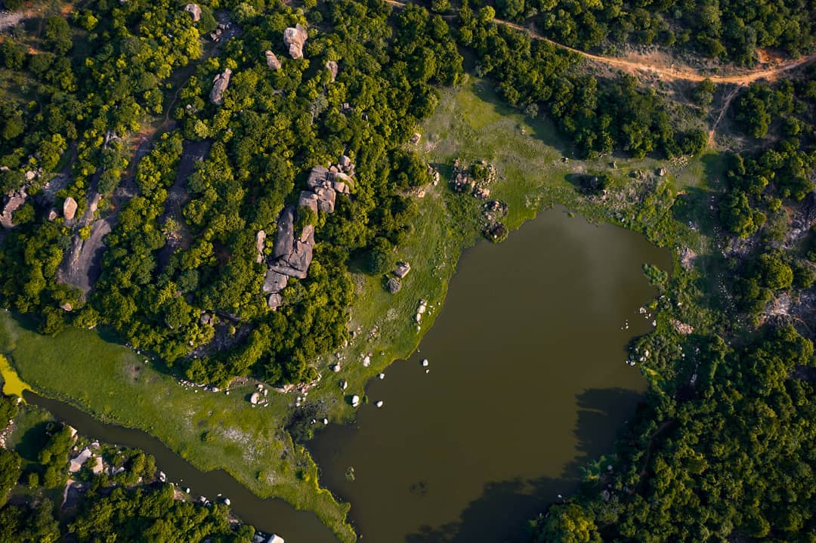
Thank You!
Image: University of Hyderabad, GachiBowli

